Slide 1

IT-1201: Data Structures
for
1st Year 2nd Semester of B.Sc (Honors) in IT (5th Batch)
Lecture: 14
Graph-1: Basic Theory
Prepared by:
K M Akkas Ali
akkas_khan@yahoo.com, akkas@juniv.edu
Associate Professor
Institute of Information Technology (IIT)
Jahangirnagar University, Dhaka-1342

Slide 2
Lecture-14:
Graph-1: Basic Theory
Objectives of this Lecture:
  Definition of graphs and related concepts
  Vertices/nodes, edges, adjacency, incidence
  Degree, in-degree, out-degree
  Subgraphs, unions, isomorphism
  Adjacency matrices
  Types of Graphs
  Trees
  Undirected graphs
  Simple graphs, Multigraphs, Pseudographs
  Digraphs, Directed multigraph
  Bipartite
  Complete graphs, cycles, wheels, cubes, complete bipartite
13.<number>

Slide 3
Some problems that can be represented by a graph
Graph Basic:
computer networks
airline flights
road map
course prerequisite structure
tasks for completing a job
flow of control through a program
many more
13.<number>

Slide 4
What is a Graph?
In mathematics, a graph is an abstract representation of a set of objects where some pairs of the objects are connected by links.
The interconnected objects are represented by mathematical abstractions called vertices (or nodes), and the links that connect some pairs of vertices are called edges.
Typically, a graph is depicted in diagrammatic form as a set of dots for the vertices, joined by lines or curves for the edges. Therefore, a graph is a finite set of nodes with edges between nodes.
Graphs are one of the objects of study in discrete mathematics.
13.<number>

Slide 5
What is a Graph?
A graph, indicated by G = (V,E), is composed of:
V: set of vertices
E: set of edges connecting the vertices in V
An edge e = (u,v) is a pair of vertices
Example of a graph:
V= {a,b,c,d,e}
E= {(a,b),(a,c),(a,d),
(b,e),(c,d),(c,e),(d,e)}
a
b
Vertices are also called nodes or points, and edges are also called lines or arcs.
c
d
e
13.<number>

Slide 6
Examples of Graphs:
What is a Graph?
V={0,1,2,3,4}
E={(0,1), (1,2), (0,3), (3,0), (2,2), (4,3)}
1
0
2
When (x,y) is an edge, we say that x is adjacent to y, and y is adjacent from x.
0 is adjacent to 1.
1 is not adjacent to 0.
2 is adjacent from 1.
4
3
13.<number>

Slide 7
What is a Graph?
The edges in a graph may be directed (asymmetric) or undirected (symmetric).
For example, if the vertices represent people at a party, and there is an edge between two people if they shake hands, then this is an undirected graph, because if person A shook hands with person B, then person B also shook hands with person A.
On the other hand, if the vertices represent people at a party, and there is an edge from person A to person B when person A knows of person B, then this graph is directed, because, one person knowing another person does not necessarily imply the reverse; for example, many fans may know of a celebrity, but the celebrity is unlikely to know of all their fans). This latter type of graph is called a directed graph and the edges are called directed edges or arcs.
13.<number>

Slide 8
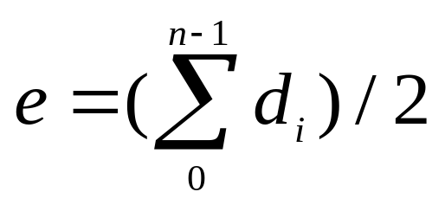

Graph Terminology:
The vertices belonging to an edge are called the ends, endpoints, or end vertices of the edge.
A vertex may exist in a graph and not belong to an edge.
The order of a graph is the number of vertices. It is denoted as |V|.
The size of a graph is the number of edges. It is denoted as |E|.
The degree of a node or vertex is the number of edges that connect to it, that is, degree of a vertex is the number of edges incident to that vertex. If u is a node, then its degree is denoted as deg(u).
For directed graph,
  the in-degree of a vertex v is the number of edges
  that have v as the head. That is, in-degree of a vertex (deg⁻) counts the number of edges that stick in to the vertex.
  the out-degree of a vertex v is the number of edges
  that have v as the tail. That is, out-degree (deg⁺) counts the number of edges sticking out.
  if d_{i} is the degree of a vertex i in a graph G with n vertices and e edges, the number of edges is
13.<number>

Slide 9
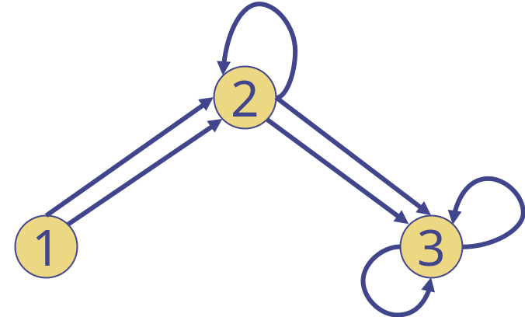
Graph Terminology:
Examples: in-degree and out-degree
Q: What are in-degrees and out-degrees of all the vertices?
Ans: deg⁻(1) = 0
deg⁻(2) = 3
deg⁻(3) = 4
deg⁺(1) = 2
deg⁺(2) = 3
deg⁺(3) = 2
13.<number>

Slide 10
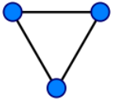
Types of Graph:
Different purposes require different types of graphs.
Undirected graph:
An undirected graph is one in which edges have no orientation. The edge (a, b) is identical to the edge (b, a), i.e., they are not ordered pairs, i.e. (v0, v1) = (v1,v0).
Figure shows a simple undirected graph with three vertices and three edges. Each vertex has degree two, so this is also a regular graph.
Figure: An undirected
graph
V=set of 6 people: John, Mary, Joe, Helen, Tom, and Paul, where the first 4 are siblings, and the last two are siblings
E ={(x,y) | x and y are siblings}
if (x,y) is an edge:
we say that x is
adjacent to y, &
y adjacent to x.
We also say that
x and y are
neighbors
Mary
Helen
John
Joe
13.<number>
Tom
Paul

Slide 11
Representations of Undirected Graphs
Types of Graph:
The same two representations for directed graphs can be used for undirected graphs
Adjacency matrix A:
  A[i][j]=1 if (i,j) is an edge; 0 otherwise
Adjacency Lists:
  L[i] is the linked list containing all the neighbors of i
13.<number>

Slide 12
Example of Representations:
Types of Graph:
Mary 0
Helen 1
Linked Lists representation:
L[0]: 1, 2, 3
L[1]: 0, 2, 3
L[2]: 0, 1, 3
L[3]: 0, 1, 2
L[4]: 5
L[5]: 4
John 2
Joe 3
Tom 4
Paul 5
Adjacency Matrix representation:
0 1 1 1 0 0
1 0 1 1 0 0
1 1 0 1 0 0
1 1 1 0 0 0
0 0 0 0 0 1
0 0 0 0 1 0
A =
13.<number>

Slide 13
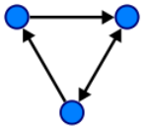
Types of Graph:
Directed graph:
A directed graph or digraph is one in which each edge is assigned a direction, or in other words, each edge is identified with an ordered pair of vertices such that <v0, v1> != <v1,v0>. The set of ordered pairs of vertices are called arcs, directed edges, or arrows.
An arc a = (x, y) is considered to be directed from x to y; y is called the head (or target) and x is called the tail (or source) of the arc; y is said to be a direct successor of x, and x is said to be a direct predecessor of y.
Figure shows a directed graph with three vertices and three edges.
Tail
x
Head
y
Figure: A directed graph
13.<number>

Slide 14
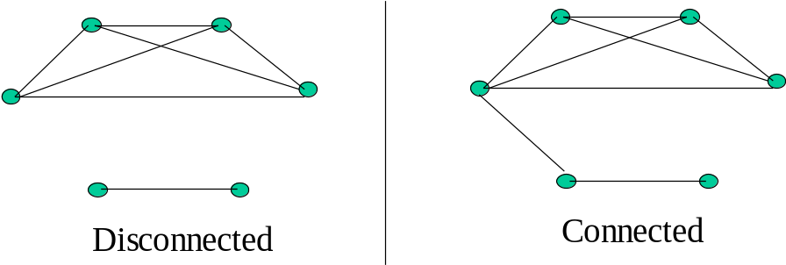
Types of Graph:
Connected graph:
An undirected graph is said to be connected if there is a path between every pair of nodes. Otherwise, the graph is disconnected.
A graph is called connected if every pair of distinct vertices in the graph is connected; otherwise, it is called disconnected.
A directed graph is called weakly connected if replacing all of its directed edges with undirected edges produces a connected (undirected) graph. It is strongly connected or strong if it contains a directed path from u to v and a directed path from v to u for every pair of vertices u, v.
13.<number>

Slide 15
Types of Graph:
Mixed graph:
A mixed graph G is a graph in which some edges may be directed and some may be undirected. It is written as an ordered triple G = (V, E, A) with V, E, and A defined as above.
Figure shows a mixed graph with three vertices and three edges.
Figure: A mixed graph
13.<number>

Slide 16
Types of Graph:
Simple graph:
A simple graph, as opposed to a multigraph, is an undirected graph that has no loops and no more than one edge between any two different vertices.
In a simple graph the edges of the graph form a set (rather than a multiset) and each edge is a distinct pair of vertices. In a simple graph with n vertices every vertex has a degree that is less than n (the converse, however, is not true — there exist non-simple graphs with n vertices in which every vertex has a degree smaller than n).
13.<number>

Slide 17
Types of Graph:
Figure shows a simple graph with four vertices and six edges.
{1,2}
1
2
{1,3}
{2,3}
{2,4}
{3,4}
3
4
{1,4}
EG: Suppose a local computer network
  Is bidirectional (undirected)
  Has no loops (no “self-communication”)
  Has unique connections between computers
Sensible to represent as follows:
Vertices are labeled to associate with particular computers
Each edge can be viewed as the set of its two endpoints
13.<number>

Slide 18
Types of Graph:
Multi graph:
A loop is an edge (directed or undirected) which starts and ends on the same vertex; these may be permitted or not permitted according to the application. In this context, an edge with two different ends is called a link.
The term "multigraph" is generally understood to mean that multiple edges (and sometimes loops) are allowed. Where graphs are defined so as to allow loops and multiple edges, a multigraph is often defined to mean a graph without loops, however, where graphs are defined so as to disallow loops and multiple edges, the term is often defined to mean a "graph" which can have both multiple edges and loops, although many use the term "pseudograph" for this meaning.
13.<number>

Slide 19
Types of Graph:
Consider the case in a local computer network again.
If computers are connected via internet instead of directly, there may be several routes to choose from for each connection. Depending on traffic, one route could be better than another.
Makes sense to allow multiple edges, but still no self-loops:
Edge-labels distinguish between edges sharing same endpoints. Labeling can be thought of as function:
e₁ → {1,2}, e₂ → {1,2}, e₃ → {1,3}, e₄ → {2,3}, e₅ → {2,3}, e₆ → {1,2}
e₁
1
2
e₂
e₄
e₃
e₅
e₆
3
4
13.<number>

Slide 20
Types of Graph:
Weighted graph:
A graph is a weighted graph if a number (weight) is assigned to each edge. Such weights might represent, for example, costs, weight, lengths or capacities, etc. depending on the problem at hand. Some authors call such a graph a network.
Regular graph:
A regular graph is a graph where each vertex has the same number of neighbors, i.e., every vertex has the same degree or valency. A regular graph with vertices of degree k is called a k‑regular graph or regular graph of degree k.
13.<number>

Slide 21
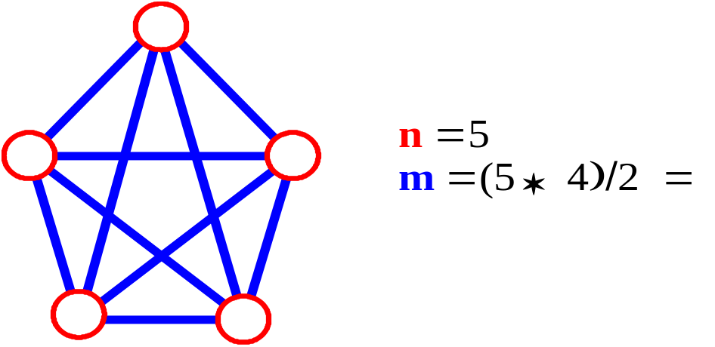
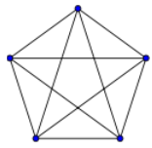
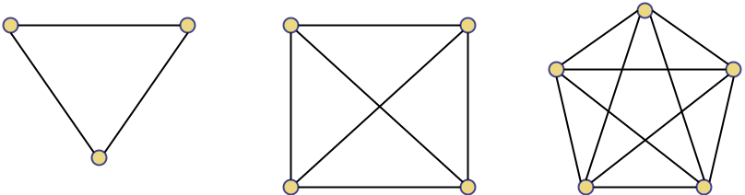
Types of Graph:
Complete graph:
Complete graphs have the feature that each pair of vertices is joined by an edge. That is, the graph contains all possible edges. Figure below shows three complete graphs. Each vertex has an edge to every other vertex.
Let n = no. of vertices, and m = no. of edges.
How many total edges in a complete graph?
  Each of the n vertices is incident to n-1 edges, however, we would have counted each edge twice! Therefore, intuitively, m = n(n -1)/2.
Therefore, if a graph is not complete, m < n(n -1)/2
Figure: A complete graph
13.<number>

Slide 22
Types of Graph:
Trivial graph:
The graph with only one vertex and no edges is called the trivial graph.
Edgeless graph:
A graph with only vertices and no edges is known as an edgeless graph.
Null or Empty graph:
The graph with no vertices and no edges is sometimes called the null graph or empty graph.
13.<number>

Slide 23
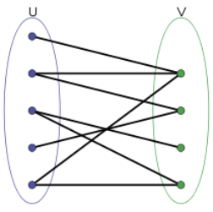
Types of Graph:
Bipartite graph (Bigraph):
A bipartite graph is a graph whose vertices can be divided into two disjoint sets , U and V, so that no two vertices in U are adjacent and no two vertices in V are adjacent. That is, every edge connects a vertex in U to one in V.
The two sets U and V may be thought of as a coloring of the graph with two colors:
- if one colors all nodes in U blue, and all nodes in V green, each edge has endpoints of differing colors, as is required in the graph coloring problem. In contrast, such a coloring is impossible in the case of a non-bipartite graph, such as a triangle: after one node is colored blue and another green, the third vertex of the triangle is connected to vertices of both colors, preventing it from being assigned either color.
Figure: A bipartite graph
13.<number>

Slide 24
Properties of a Graph:
Adjacent edges:
Two edges of a graph are called adjacent (sometimes coincident) if they share a common vertex. Two arrows of a directed graph are called consecutive if the head of the first one is at the nock (notch end) of the second one.
Adjacent nodes or neighbor or vertices:
Two vertices are called adjacent if they share a common edge . In this case, the common edge is said to join the two vertices.
A vertex is incident with an edge (and the edge is incident with the vertex) if it is the endpoint of the edge. Two vertices are called consecutive if they are at the notch and at the head of an arrow.
13.<number>

Slide 25
Properties of a Graph:
Q: In the figure below, which vertices are adjacent to 1? How about adjacent to 2, 3, and 4?
e₁
1
e₂
2
Ans: 1 is adjacent to 2 and 3
2 is adjacent to 1 and 3
3 is adjacent to 1 and 2
4 is not adjacent to any vertex
e₄
e₃
e₅
e₆
3
4
Q: Which edges are incident to 1? How about incident to 2, 3, and 4?
Ans:
e₁, e₂, e₃, e₆ are incident with 2
2 is incident with e₁, e₂, e₄, e₅, e₆
3 is incident with e₃, e₄, e₅
4 is not incident with any edge
13.<number>

Slide 26
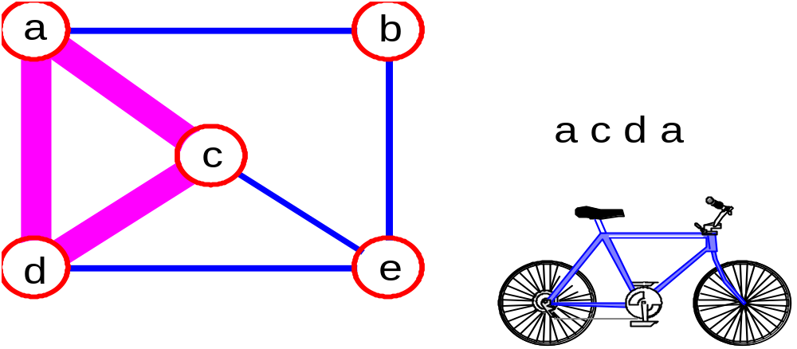
Properties of a Graph:
Path:
It is the sequence of vertices v₁,v₂,. . .v_{k} such that consecutive vertices v_{i} and v_{i+1} are adjacent.
Simple path:
It is a path with no repeated vertices.
Cycle:
It is a simple path, except that the last vertex is the same as the first vertex
3
2
3
3
3
a
b
a
b
c
c
d
e
d
e
Cycle: acda
a b e d c
Simple path: b e d c
13.<number>

Slide 27
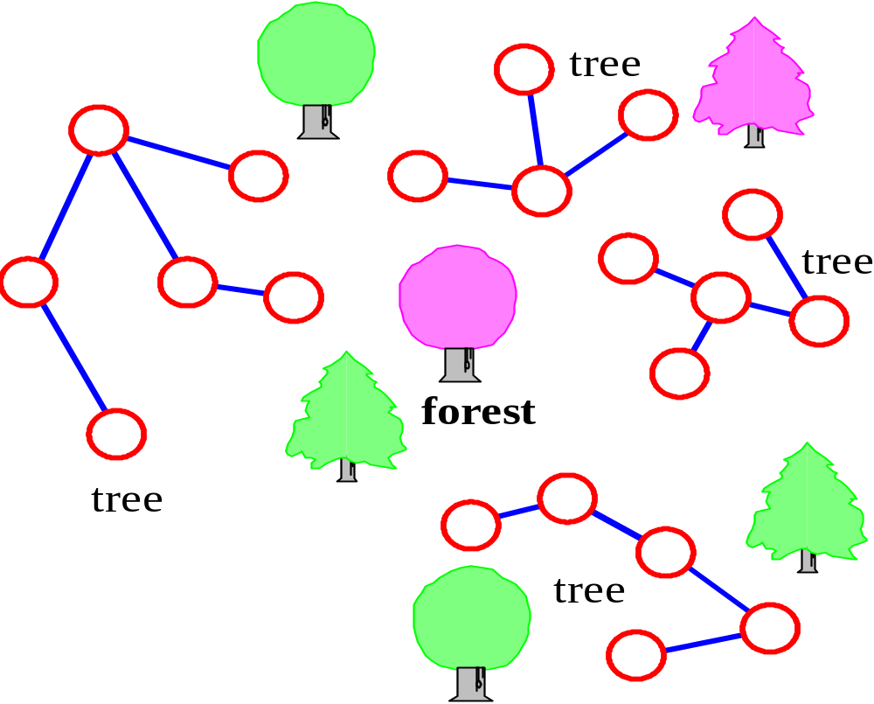
Properties of a Graph:
Tree - connected graph without cycles
Forest - collection of trees
13.<number>

